Slide 1
Phishing Awareness Training
Understand phishing attacks and how to avoid them effectively.

Slide 2
presented by Shafay Nadeem

Slide 3

Introduction
This training module aims to provide comprehensive knowledge about phishing attacks, including their recognition and prevention strategies.

Slide 4
01
Phishing Overview

Slide 5
Definition of phishing
Phishing is a cybercrime where attackers impersonate legitimate organizations to deceive individuals into providing sensitive information such as usernames, passwords, and credit card details. These attacks often utilize fraudulent emails and websites.

Slide 6

Types of phishing attacks
Common types of phishing include email phishing, spear phishing (targeted attacks), whaling (targeting high-profile individuals), and smishing (mobile phishing via SMS). Each type employs different techniques to lure victims and exploit their trust.

Slide 7
Impact of phishing
Phishing attacks can have severe consequences for individuals and organizations. These include financial losses due to fraudulent transactions, loss of sensitive data, damage to reputation, and operational disruption. Moreover, the recovery process can be costly, involving legal fees, cybersecurity audits, and increased security measures.

Slide 8
02
Recognizing Phishing

Slide 9
Identifying phishing emails
To identify phishing emails, look for common red flags such as generic greetings, unexpected attachments, and urgent language urging immediate action. Additionally, check the sender's email address for discrepancies and hover over links to reveal their true destination.

Slide 10
Spotting fake websites
Fake websites often mimic legitimate ones but may have subtle differences in URL or design. Look for secure connections (HTTPS), unauthorized content, and excessive pop-ups. Trust your instincts; if a website seems off, it is better to verify before proceeding.

Slide 11

Understanding social engineering tactics
Social engineering exploits human psychology to deceive victims. Phishing, baiting, and pretexting are common tactics used to manipulate individuals into divulging confidential information. Awareness of these tactics is crucial to prevent falling victim to such schemes.

Slide 12
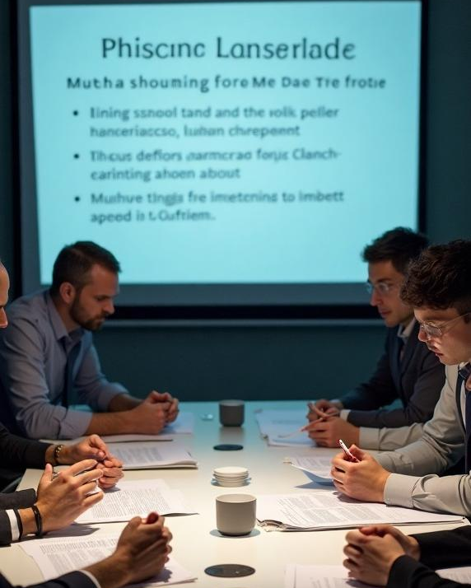
Conclusions
Phishing remains a prevalent threat in today's digital landscape. Understanding the types, impacts, and recognition methods is vital for safeguarding personal and organizational information. Continuous education on best practices is essential in defending against these scams.

Slide 13
Thank you
Stay Safe. Stay Aware!

